Slide 1
Welcome to Hour of Program
Notes:
Welcome to the hour of program this is a couse by harvard. Usually called cs50

Slide 2
About me
I am in 7th grade and i have been coding scene i was in 4th grade and i love it
My fav list
Food: pizza language:python
Game: fortnite OS: omarchy
Sport: tennis IDE: zed
Pet: parrots Course:boot.dev
Font: jetbrains mono nerd font theme:catppuccin
Notes:
I am in 7th grade and i have been coding scene i was in 4th grade and i love it
My fav list
Food: pizza language:python
Game: fortnite OS: omarchy Sport: tennis IDE: zed Pet: parrots Course:boot.dev Font: jetbrains mono nerd font theme:catppuccin

Slide 3
What about you?
Notes:
What about you guys?

Slide 4
AI
AI will NOT be allowed at all if you are caught using AI for your code you will have to leave AND your project will not be accepted.
If you have a question ask US or look at stack overflow or ask duck AI at cs50.ai
Notes:
AI will NOT be allowed at all if you are caught using AI for your code you will have to leave AND your project will not be accepted.
If you have a question ask US or look at stack overflow or ask duck AI at cs50.ai
cs50.ai is a platform that does not give you the answers when you ask

Slide 5
Practice
If you want more practice please go to https://cs50.harvard.edu/x/ week 0
Also for legal reasons i did not make this course. This course falls under the Attribution-NonCommercial-ShareAlike 4.0 International this means that you can change and share this course with credit https://cs50.harvard.edu/x/license/
Notes:
If you want more practice please go to https://cs50.harvard.edu/x/ week 0

Slide 6
What we will be doing today
Today we will do week 0 of the cs50 courses by harvard. This week you will learn the basics of programing with a program called scratch.
Notes:
Today we will do week 0 of the cs50 courses by harvard. This week you will learn the basics of programing with a program called scratch.

Slide 7
What is programing
Computer programming is about taking some input and creating some output - thus solving a problem. What happens in between the input and output, what we could call a black box, is the focus of this course.
input →
→ output
Notes:
Computer programming is about taking some input and creating some output - thus solving a problem. What happens in between the input and output, what we could call a black box, is the focus of this course.
For example let’s say that we need to know who is here we can use a system called binary to count everyone

Slide 8
binary
Computers today use something called binary (or base 2) witch has two numbers 1 and 0
Now how can we count with this?
Notes:
Now what is binary? Binary is how computers count

Slide 9
We can add a new digit then we can make that 2
10
Then 3
11
Then four is
100
Then 5
101
Then 6
110
Finally 7
111
128 | 64 | 32 | 16 | 8 | 4 | 2 | 1
0 | 0 | 0 | 0 | 0 | 0 | 0 | 0

Slide 10
Just as numbers are binary patterns of ones and zeros, letters are represented using ones and zeros, too!
Since there is an overlap between the ones and zeros that represent numbers and letters, the ASCII standard was created to map specific letters to specific numbers.
For example, the letter A was decided to map to the number 65. 01000001 represents the number 65 in binary. You can visualize this as follows:
128 | 64 | 32 | 16 | 8 | 4 | 2 | 1
0 | 1 | 0 | 0 | 0 | 0 | 0 | 1

Slide 11
If you received a text message, the binary under that message might represent the numbers 72, 73, and 33. Mapping these out to ASCII, your message would look as follows:
H I !
72 73 33

Slide 12
As time has rolled on, there are more and more ways to communicate via text.
Since there were not enough digits in binary to represent all the various characters that could be represented by humans, the Unicode standard expanded the number of bits that can be transmitted and understood by computers. Unicode includes not only special characters, but emoji as well.
There are emoji that you probably use every day. The following may look familiar to you: 😀😂😅😎😡😐

Slide 13
Zeros and ones can be used to represent color.
Red, green, and blue (called RGB) are a combination of three numbers.
Taking our previously used 72, 73, and 33, which said HI! via text, would be interpreted by image readers as a light shade of yellow. The red value would be 72, the green value would be 73, and the blue would be 33.
72 | 73 | 33

Slide 14
Problem-solving is central to computer science and computer programming. An algorithm is a step-by-step set of instructions to solve a problem.
Imagine the basic problem of trying to locate a single name in a phone book.
How might one go about this?
One approach could be to simply read from page one to the next to the next until reaching the last page.
Another approach could be to search two pages at a time.
A final and perhaps better approach could be to go to the middle of the phone book and ask, “Is the name I am looking for to the left or to the right?” Then, repeat this process, cutting the problem in half and half and half.
Each of these approaches could be called algorithms. The speed of each of these algorithms can be pictured as follows in what is called big-O notation:

Slide 15
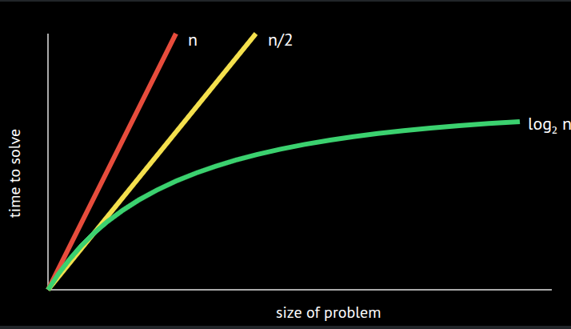

Slide 16
Notice that the first algorithm, highlighted in red, has a big-O of n because if there are 100 names in the phone book, it could take up to 100 tries to find the correct name. The second algorithm, where two pages were searched at a time, has a big-O of n/2 because we searched twice as fast through the pages. The final algorithm has a big-O of log₂n, as doubling the problem would only result in one more step to solve the problem.
Programmers translate text-based, human instructions into code to solve problems.

Slide 17
Notice that the first algorithm, highlighted in red, has a big-O of n because if there are 100 names in the phone book, it could take up to 100 tries to find the correct name. The second algorithm, where two pages were searched at a time, has a big-O of n/2 because we searched twice as fast through the pages. The final algorithm has a big-O of log₂n, as doubling the problem would only result in one more step to solve the problem.
Programmers translate text-based, human instructions into code to solve problems.

Slide 18
Pseudocode is human-readable instructions that often describe the steps of an algorithm.
The ability to create pseudocode is central to one’s success in both this class and in computer programming.
For example, considering the third algorithm above, we could compose pseudocode as follows:
1 Pick up phone book
2 Open to middle of phone book
3 Look at page
4 If person is on page
5 Call person
6 Else if person is earlier in book
7 Open to middle of left half of book
8 Go back to line 3
9 Else if person is later in book
10 Open to middle of right half of book
11 Go back to line 3
12 Else
13 Quit

Slide 19
Pseudocoding is such an important skill for at least two reasons. First, when you pseudocode before you create formal code, it allows you to think through the logic of your problem in advance. Second, when you pseudocode, you can later provide this information to others that are seeking to understand your coding decisions and how your code works. Notice that the language within our pseudocode has some unique features. First, some of these lines begin with verbs like pick up, open, look at. Later, we will call these functions.
Second, notice that some lines include statements like if or else if. These are called conditionals.
Third, notice how there are expressions that can be stated as true or false, such as “person is earlier in the book.” We call these boolean expressions.
Finally, notice how there are statements like “go back to line 3.” We call these loops.
These building blocks are the fundamentals of programming. In the context of Scratch, which is discussed below, we will use each of the above basic building blocks of programming.

Slide 20
You will be learning this week about Scratch, a visual programming language. Then, in future weeks, you will learn about C. That will look something like this:
#include <stdio.h>
int main(void)
{
printf("hello, world\n");
}
By learning C, you will be far more prepared for future learning in other programming languages like Python.
Notice how programmers have used abstraction to build off the work of other programmers. Rather than programming in ones and zeroes, programming languages were created to abstract away from the incredibly challenging task of programming in binary to more and more easy-to-use programming languages. We can stand on the shoulders of others!

Slide 21
Scratch is a visual programming language developed by MIT.
Scratch utilizes the same essential coding building blocks that we covered earlier in this lecture.
Scratch is a great way to get into computer programming because it allows you to play with these building blocks in a visual manner, not having to be concerned about the syntax of curly braces, semicolons, parentheses, and the like.
Scratch IDE (integrated development environment) looks like the following:

Slide 22
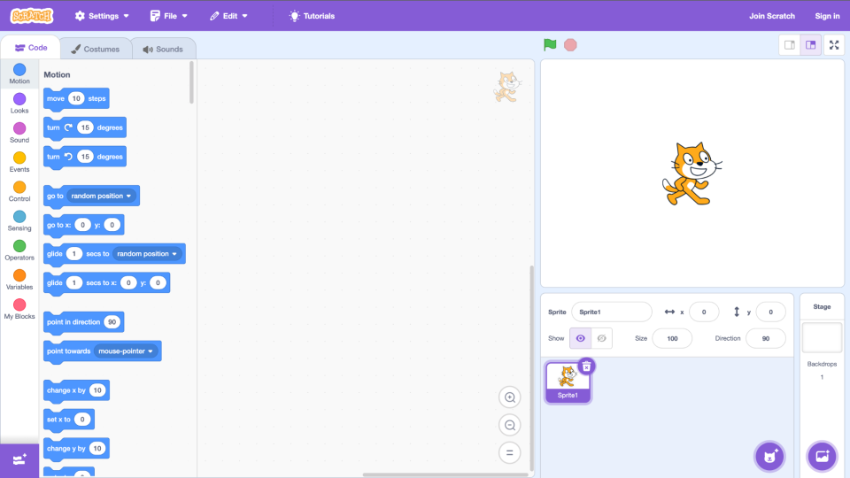
Notice that on the left, there is a palette of building blocks that you can use in your programming. To the immediate right of the building blocks, there is the area to which you can drag blocks to build a program. To the right of that, you see the stage where a cat stands. The stage is where your programming comes to life.
Scratch operates on a coordinate system as follows:

Slide 23
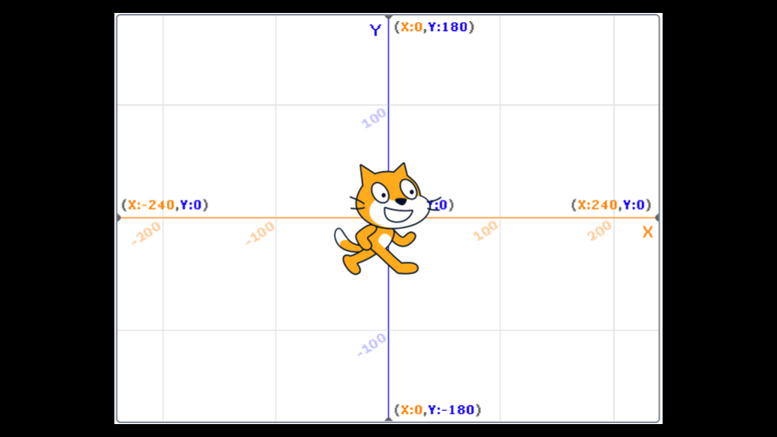

Slide 24
Now lets watch David Malan do it

Slide 25
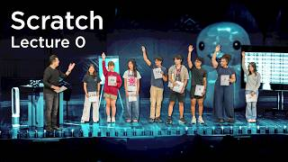
Now lets watch David Malan do it

Slide 26
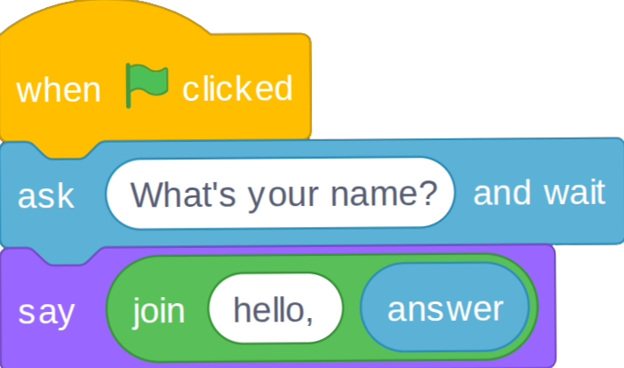
We can make your program more interactive by having the cat say hello to someone specific. We do that with this code.
Notice that when the green flag is clicked, the function ask is run. The program prompts you, the user, What's your name? It then stores that name in the variable called answer. The program then passes answer to a special function called join, which combines two strings of text hello, and whatever name was provided. The value of answer is passed as an argument to join. These collectively are passed to the say function. The cat says, Hello, and a name. Your program is now interactive.
Throughout this course, you will be providing inputs into an algorithm and getting outputs. This can be pictured in terms of the above program as follows:

Slide 27
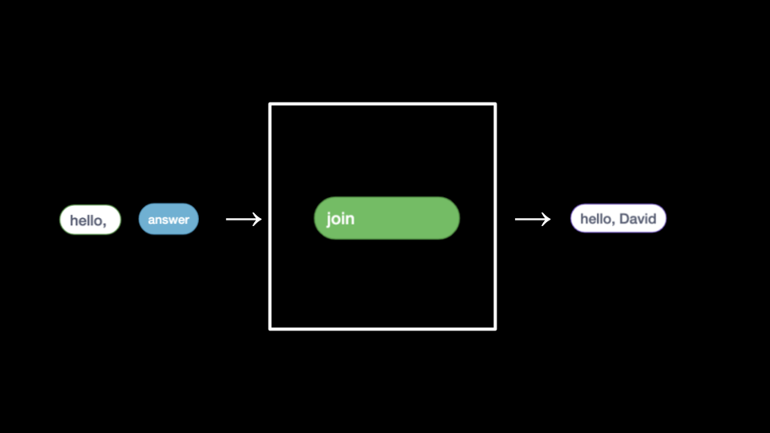
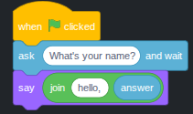
We can make your program more interactive by having the cat say hello to someone specific. We do that with this code.
Notice that when the green flag is clicked, the function ask is run. The program prompts you, the user, What's your name? It then stores that name in the variable called answer. The program then passes answer to a special function called join, which combines two strings of text hello, and whatever name was provided. The value of answer is passed as an argument to join. These collectively are passed to the say function. The cat says, Hello, and a name. Your program is now interactive.
Throughout this course, you will be providing inputs into an algorithm and getting outputs. This can be pictured in terms of the above program as follows:

Slide 28
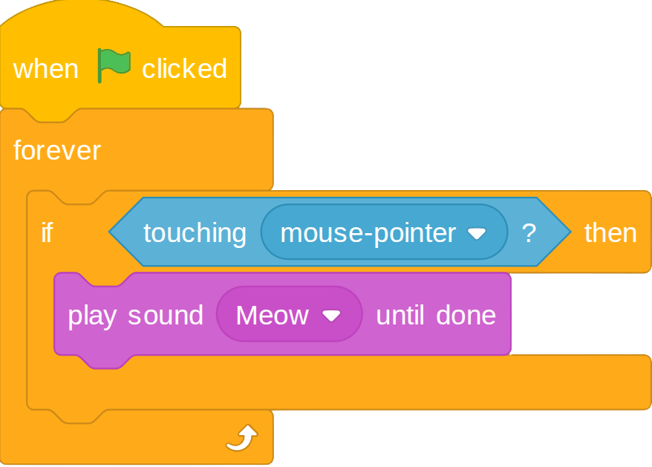
Conditionals are an essential building block of programming, where the program looks to see if a specific condition has been met. If a condition is met, the program does something.
To illustrate a conditional, write code as follows:

Slide 29
Ok we are almost done now we have to do some examples

Slide 30
Ok we are almost done now we have to do some examples

Slide 31
Ok we are done now!!! You can now take a breath

Slide 32
Ok i have sad news

Slide 33
You have homework😭

Slide 34
You have to make a scratch game
Rules: you have to use what you learned, it has to be school appropriate, and you have to post it in the link on the canvas page

Slide 35
Well that is all i have thank you for paying attention and have a good day

